Slide 1

RUNGTA COLLEGE OF DENTAL SCIENCES AND RESEARCH
THYROID DISORDER
DEPARTMENT OF GENERAL MEDICINE

Slide 2
SPECIFIC LEARNING OBJECTIVES
MUST KNOW | NICE TO KNOW | DESIRE TO KNOW
THYROID | ETHICS AND STANDARD OF PRACTICE | OBJECTIVES
HORMONES ASSOCIATED
HYPERTHYROIDISM
HYPOTHYROIDISM

Slide 3
CONTENTS
INTRODUCTION
OBJECTIVES
THYROID
HORMONES ASSOCIATED
HYPERTHYROIDISM
HYPOTHYROIDISM
ETHICS/ STANDARDS OF PRACTICE
SUMMARY

Slide 4
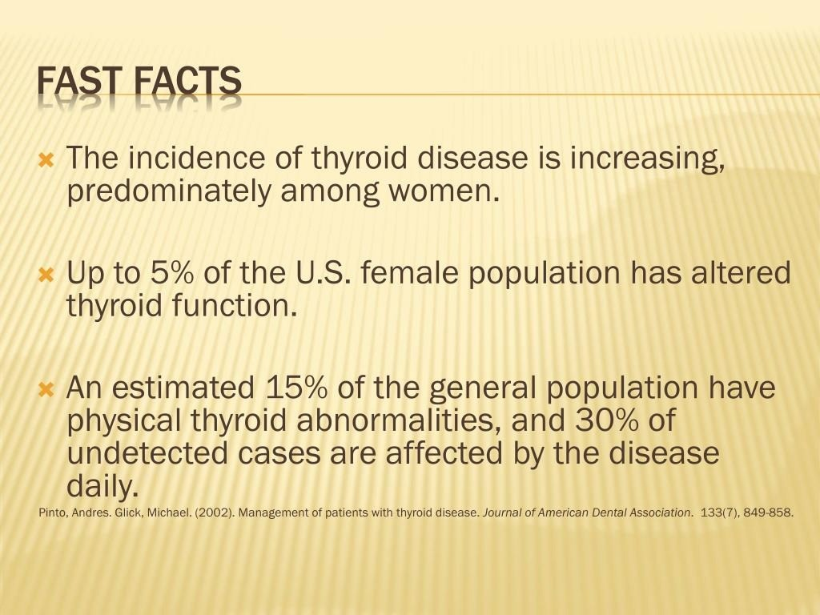

Slide 5
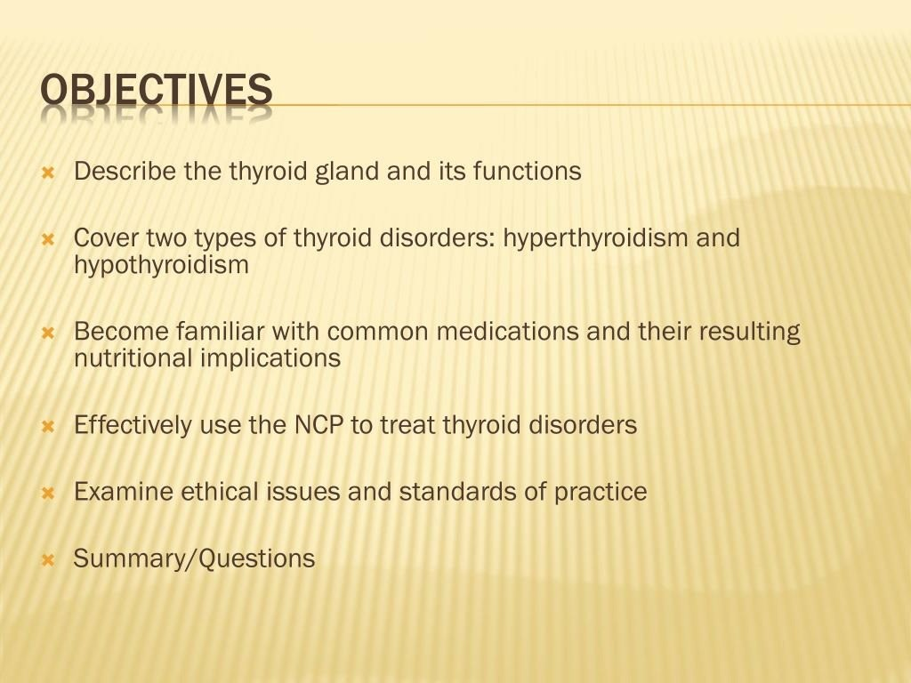

Slide 6
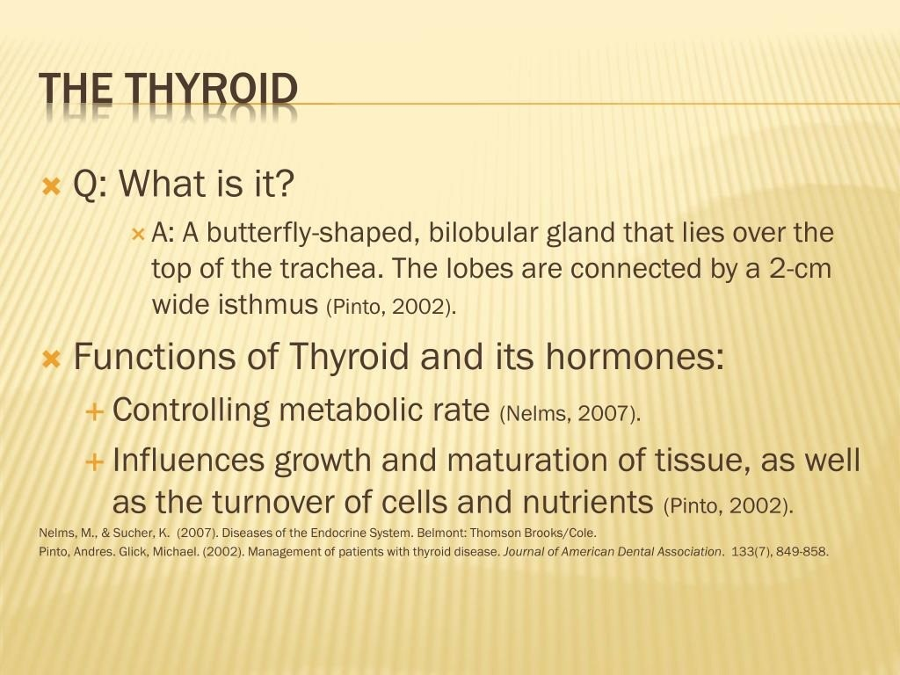

Slide 7
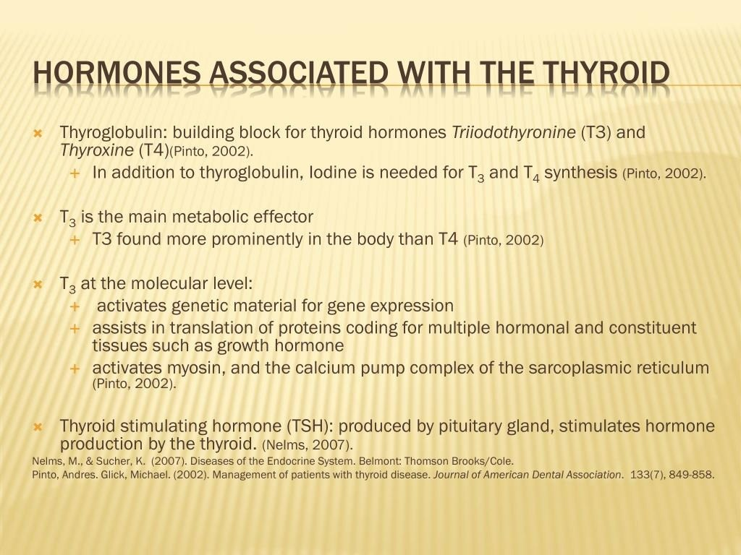

Slide 8
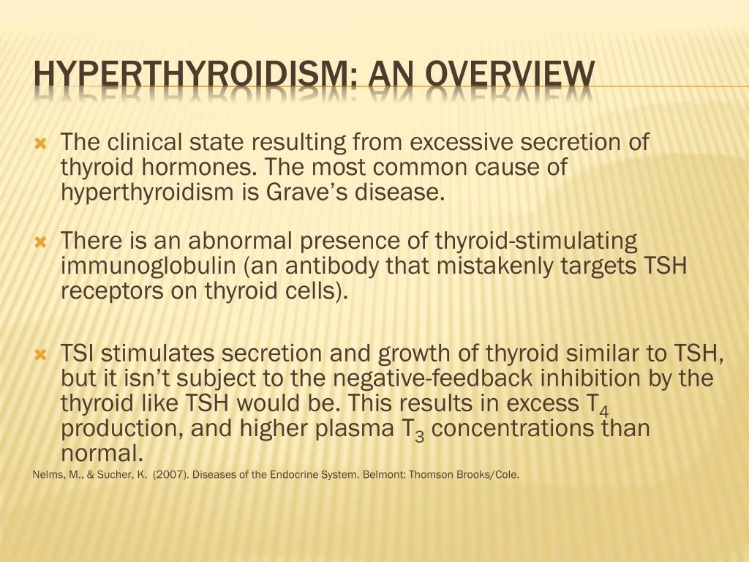

Slide 9
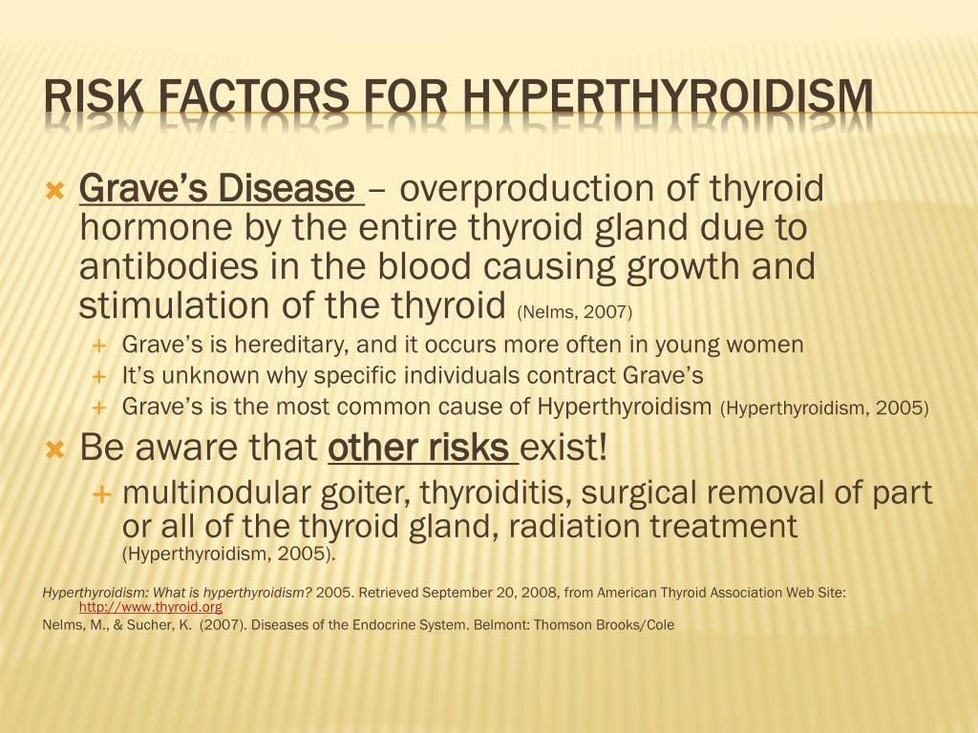

Slide 10
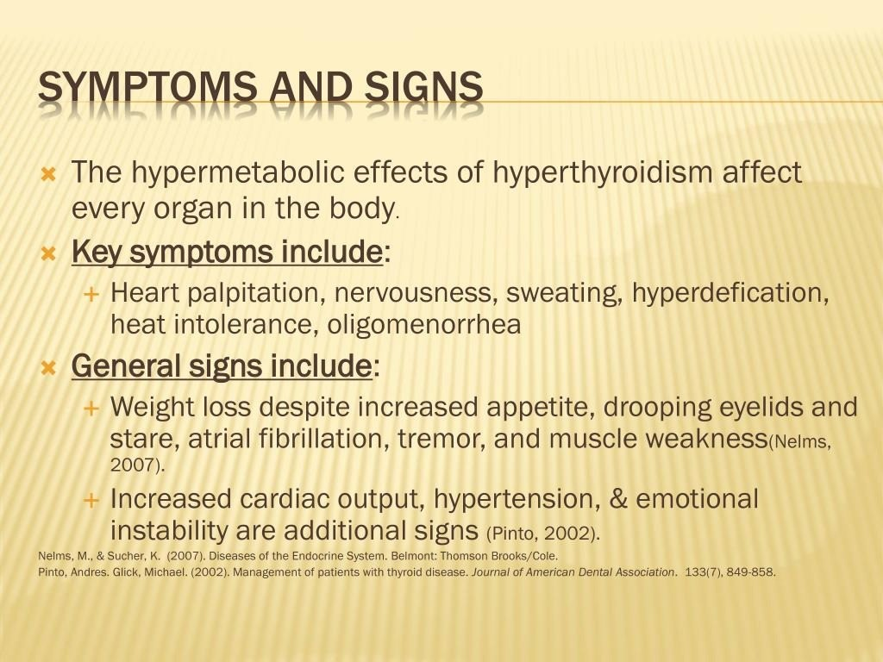

Slide 11
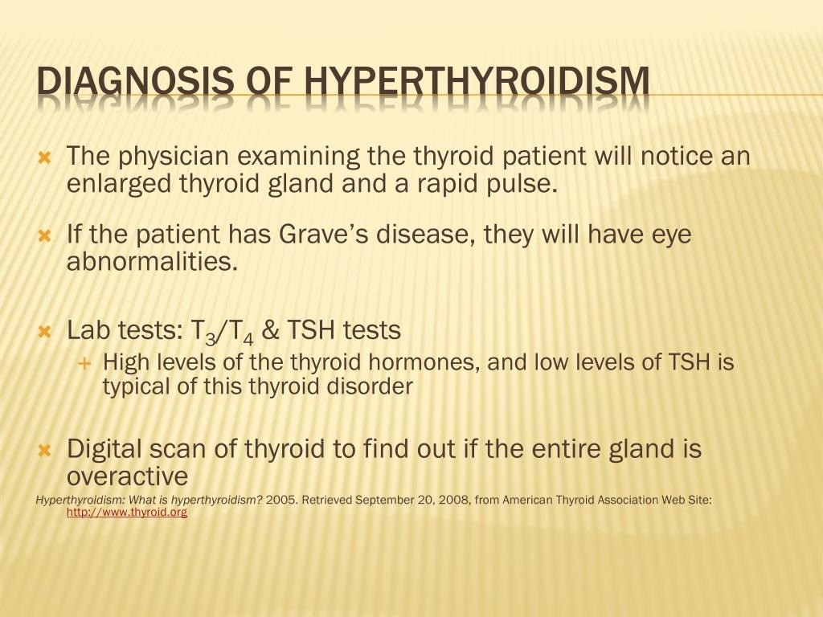

Slide 12
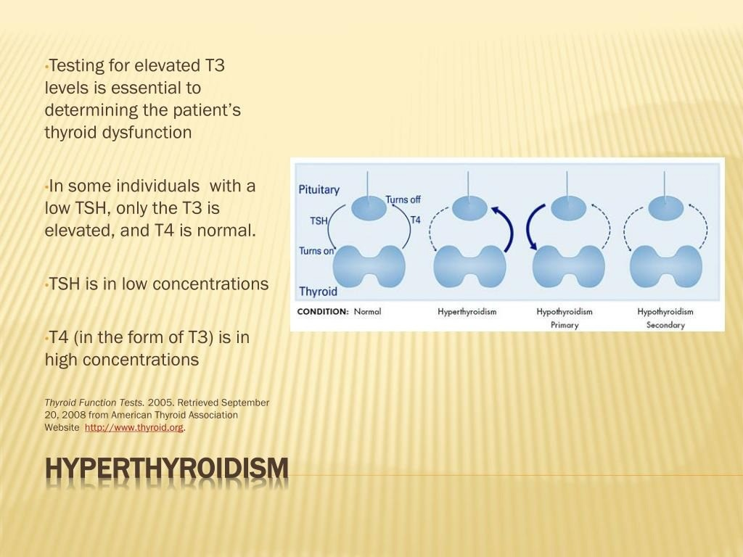

Slide 13
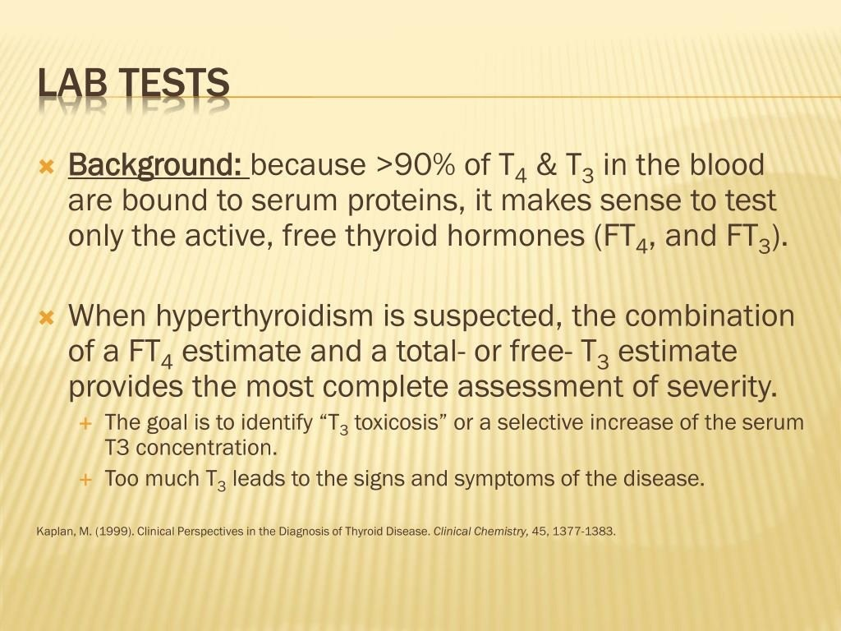

Slide 14
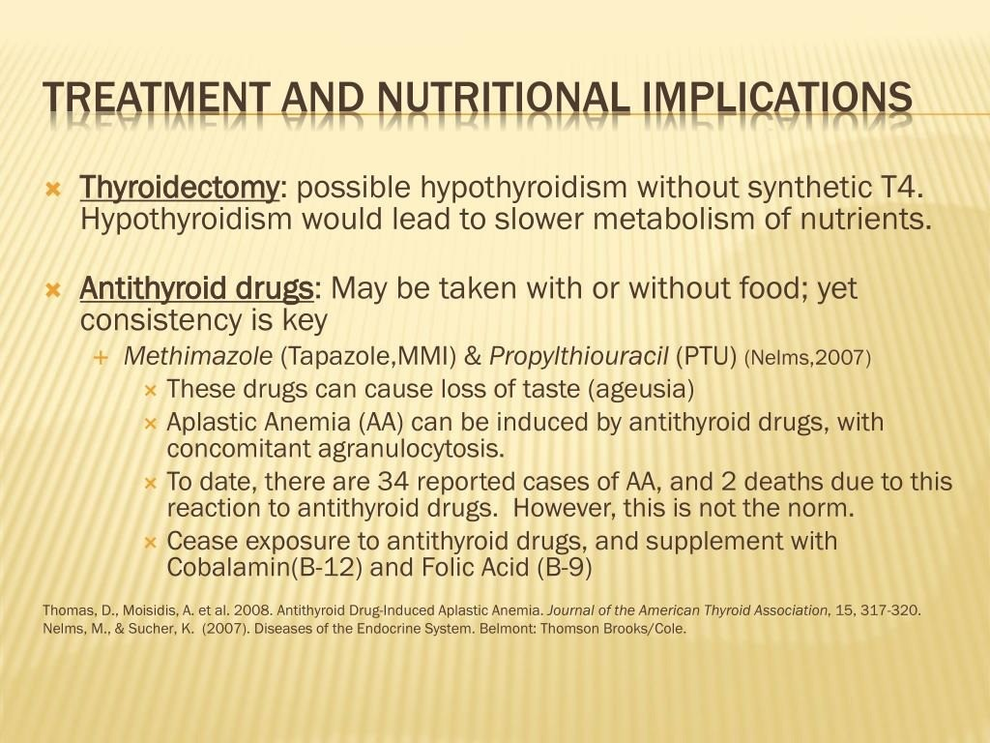

Slide 15
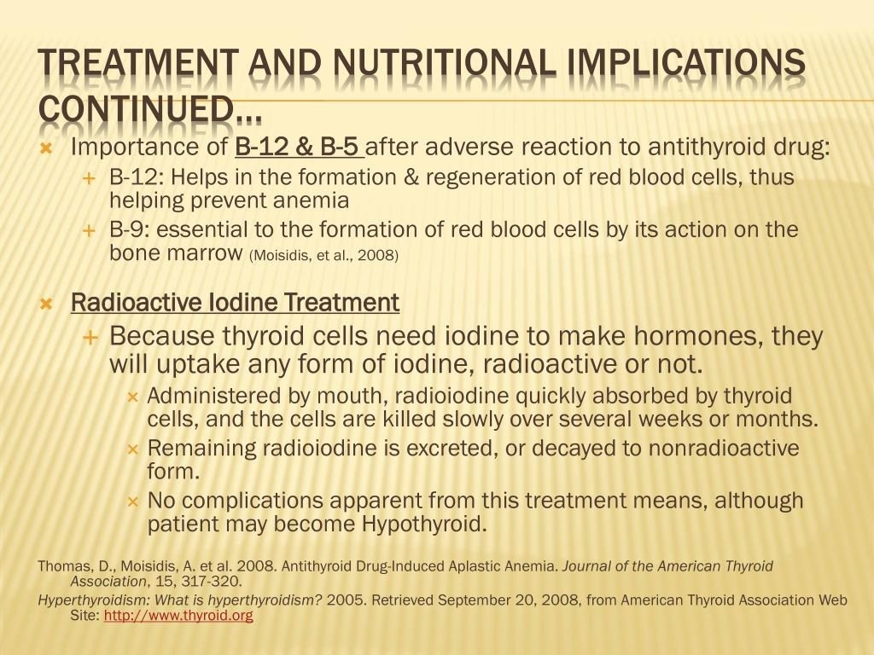

Slide 16
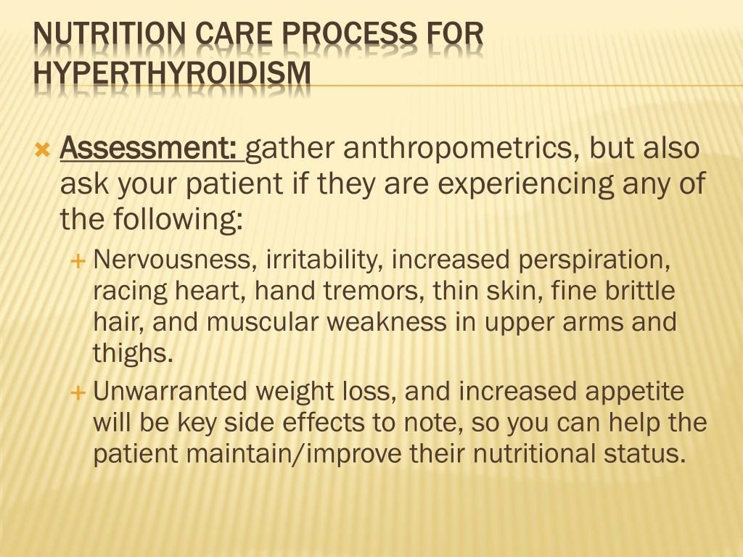

Slide 17
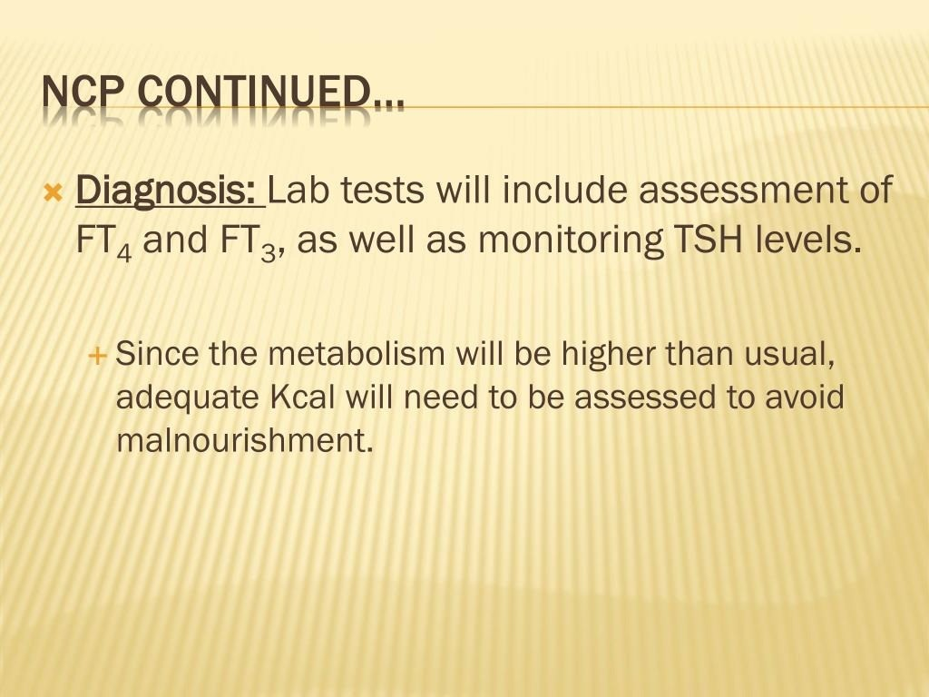

Slide 18
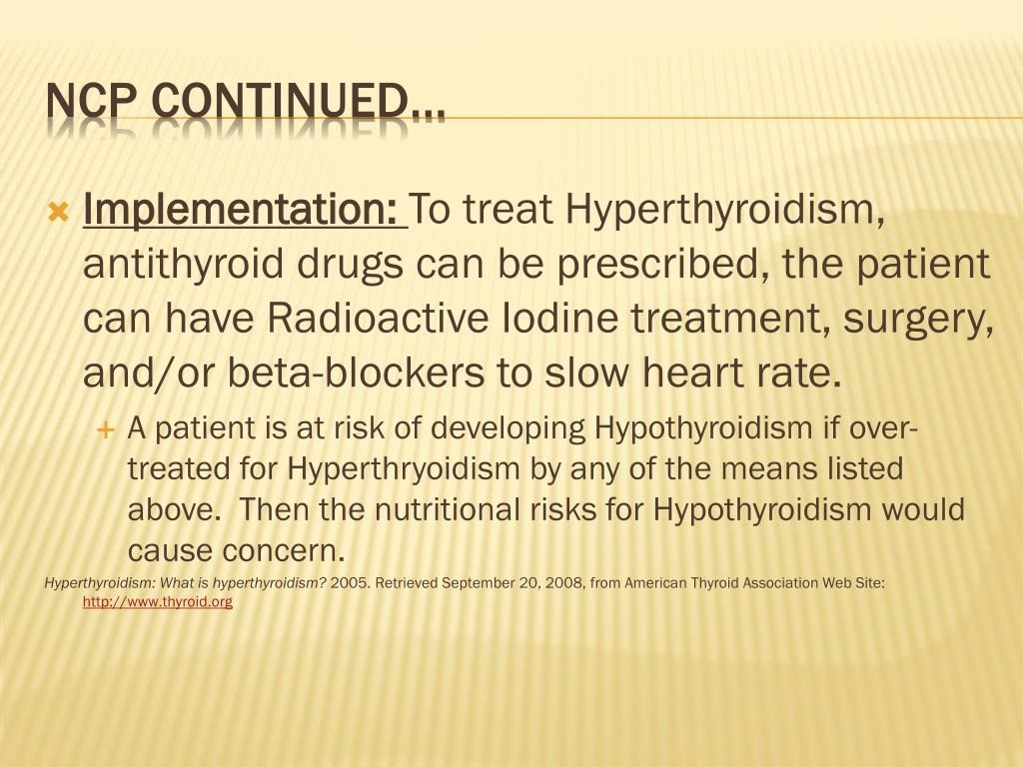

Slide 19
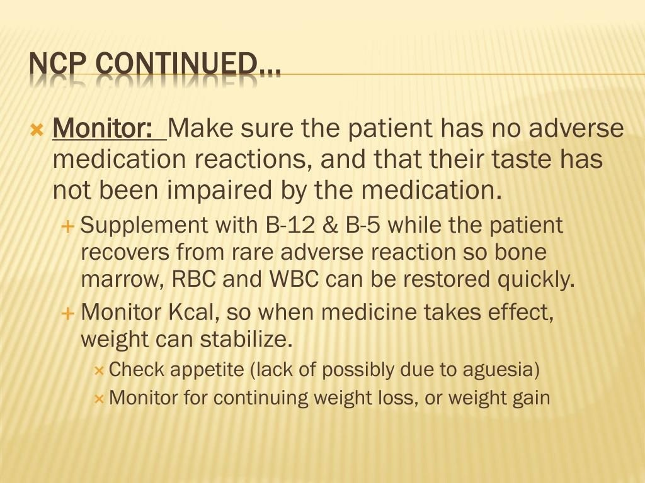

Slide 20
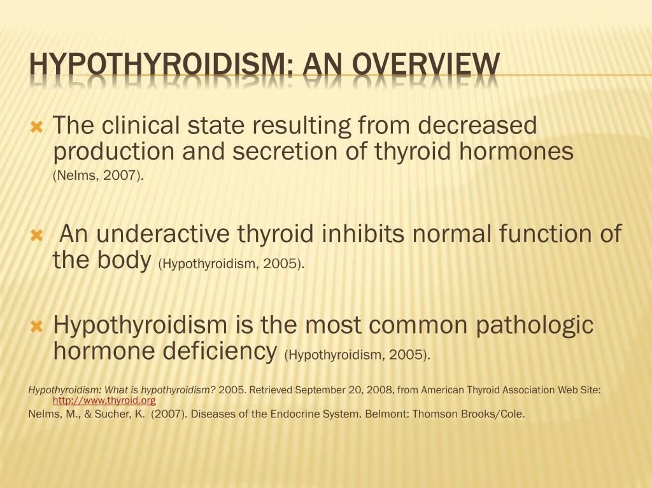

Slide 21
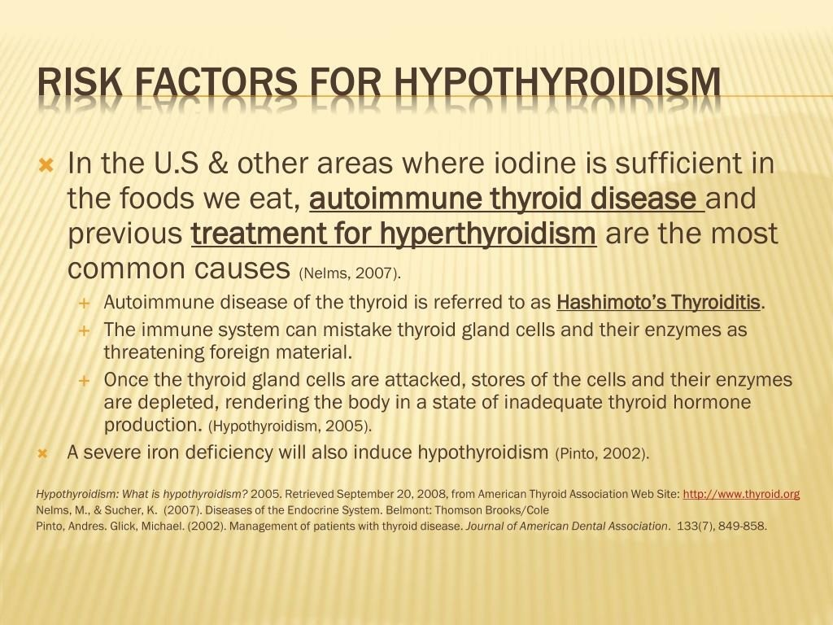

Slide 22
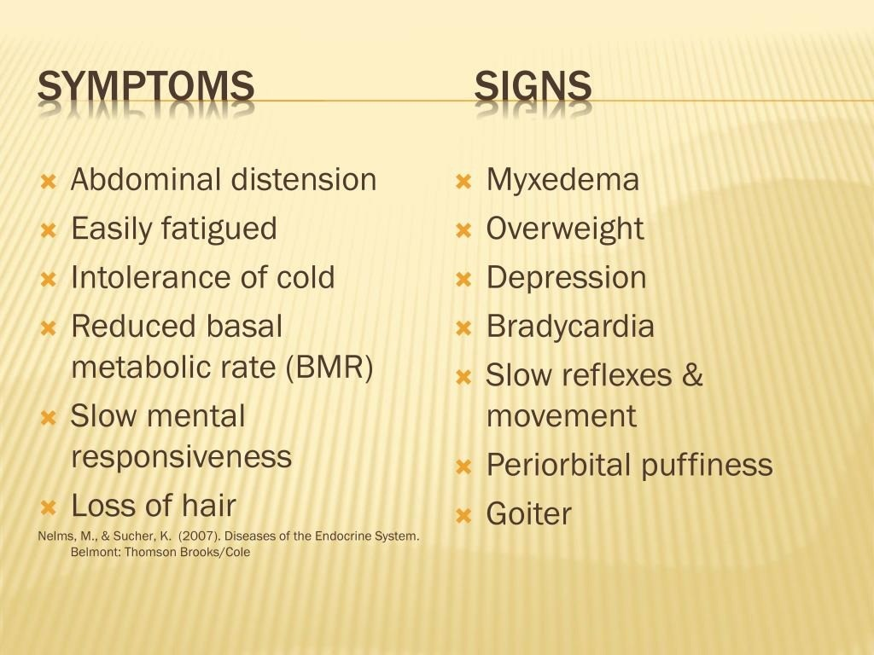

Slide 23
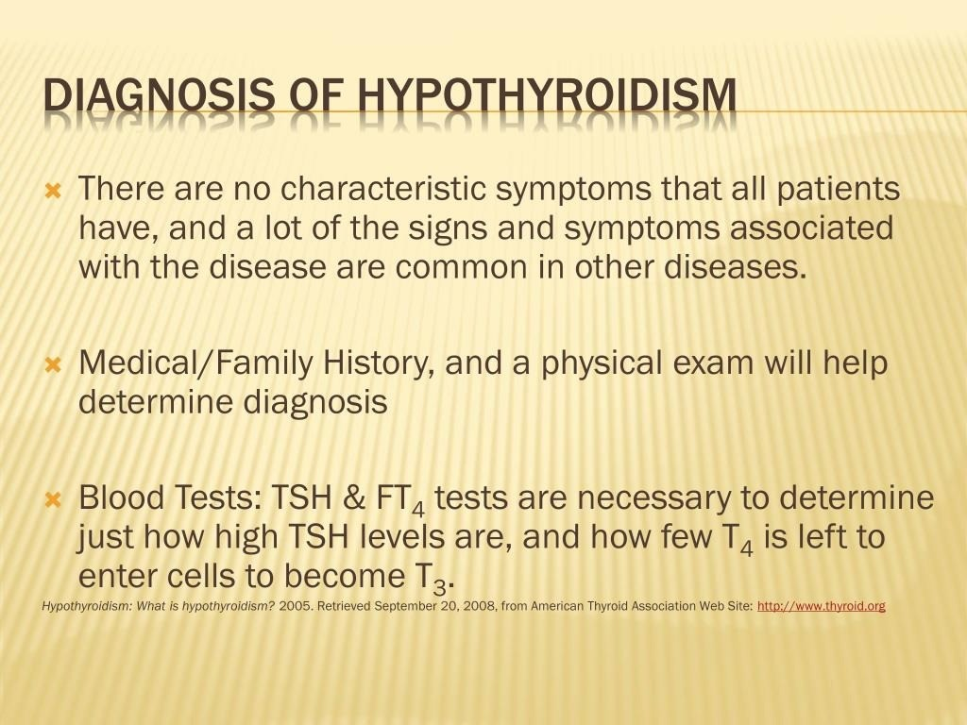

Slide 24
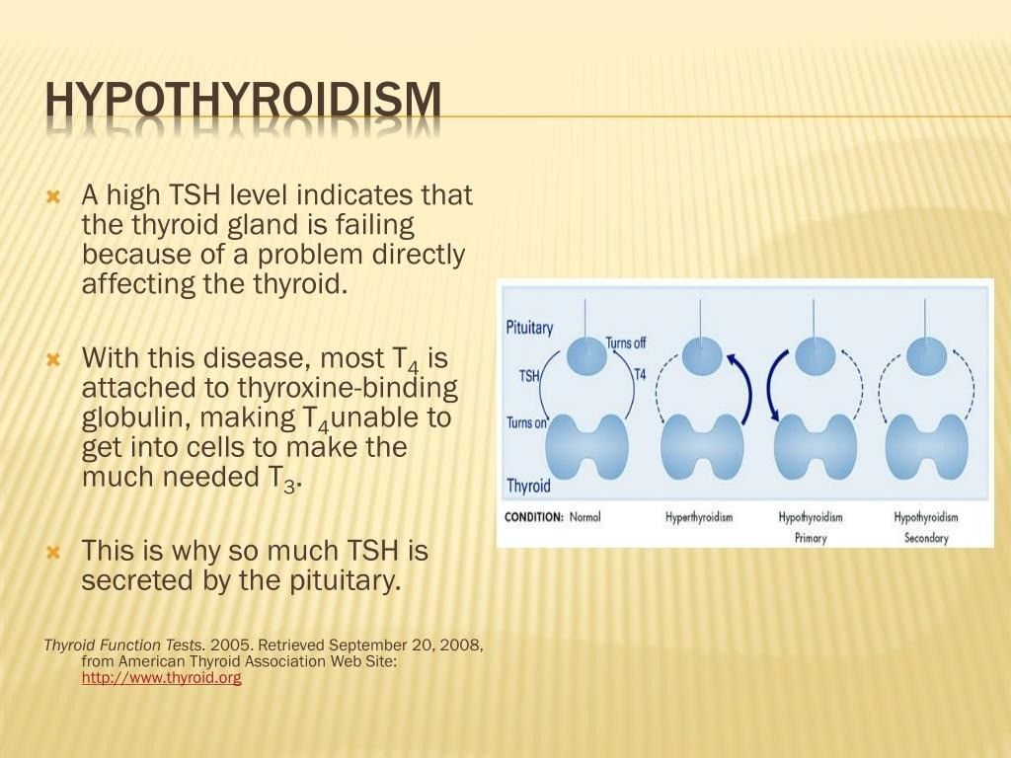

Slide 25
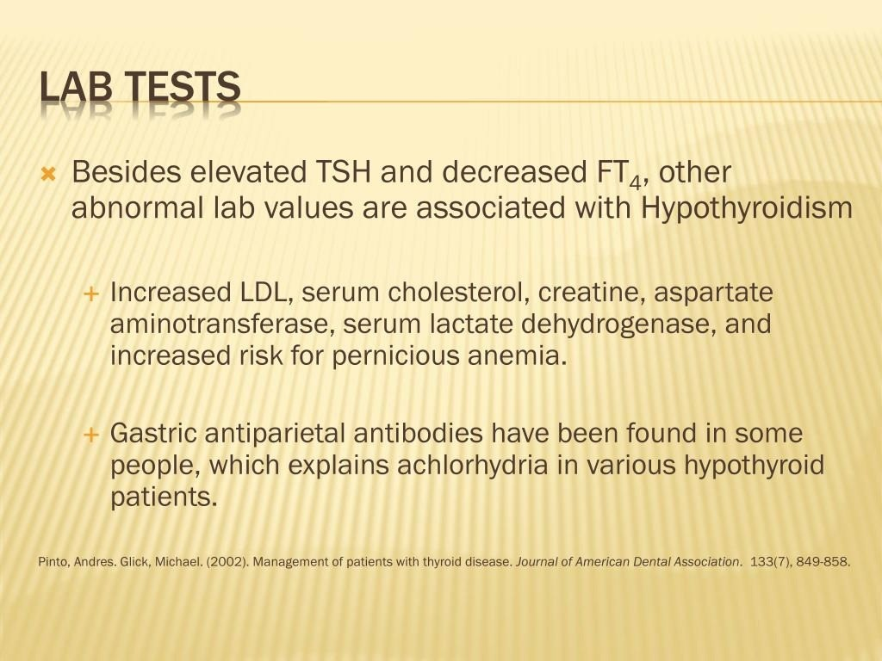

Slide 26
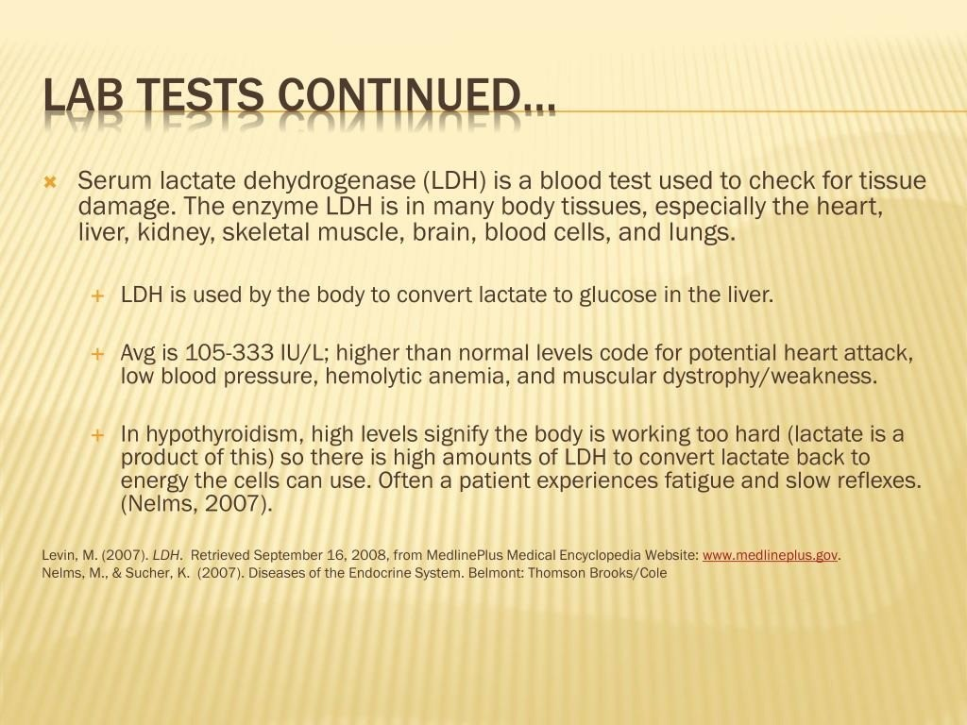

Slide 27
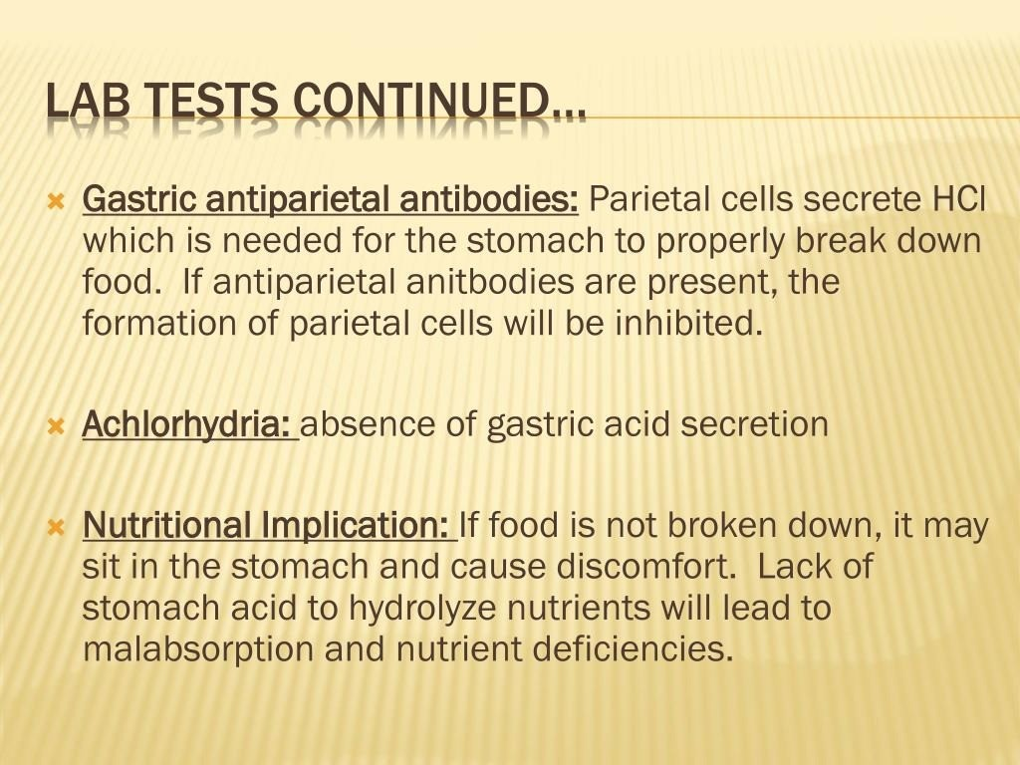

Slide 28
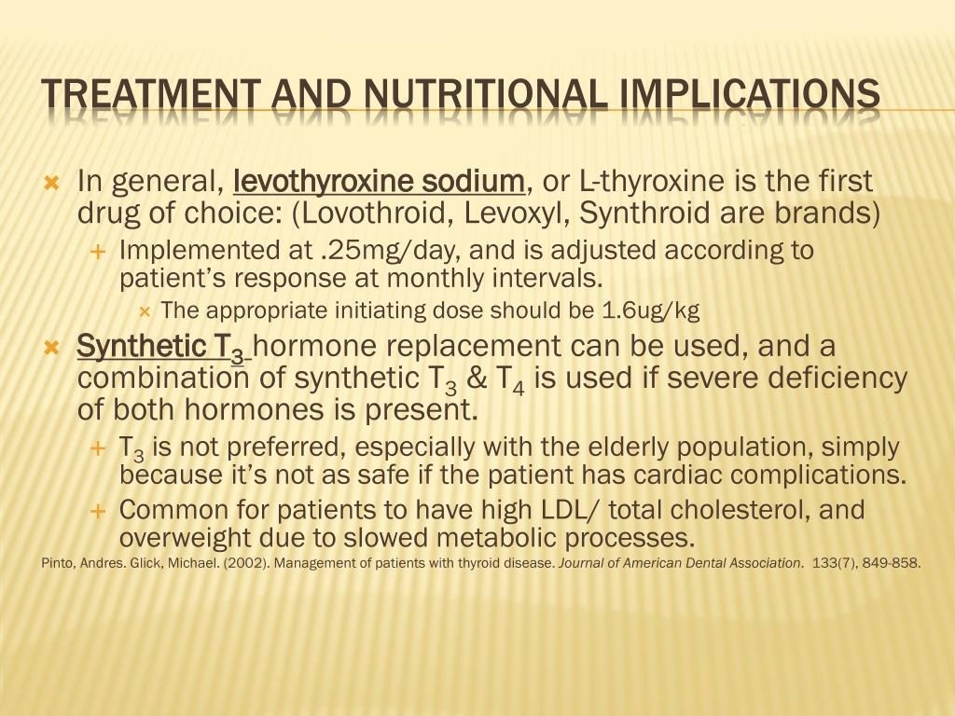

Slide 29
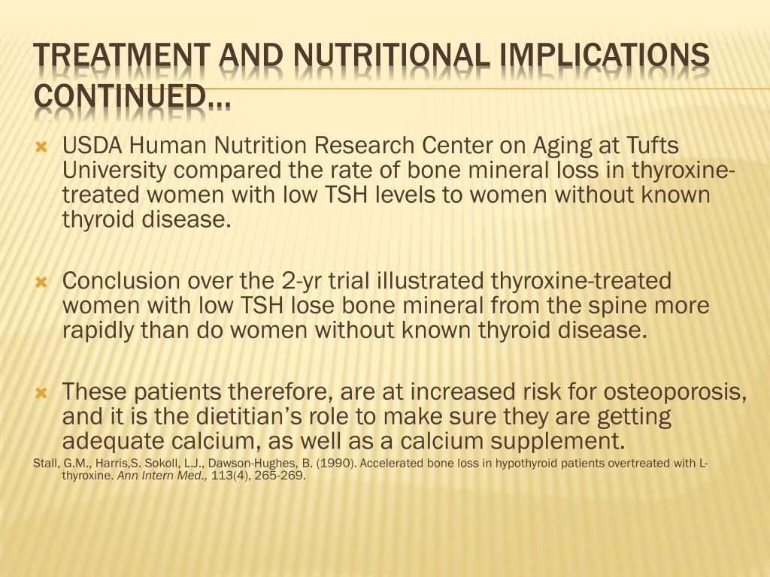

Slide 30
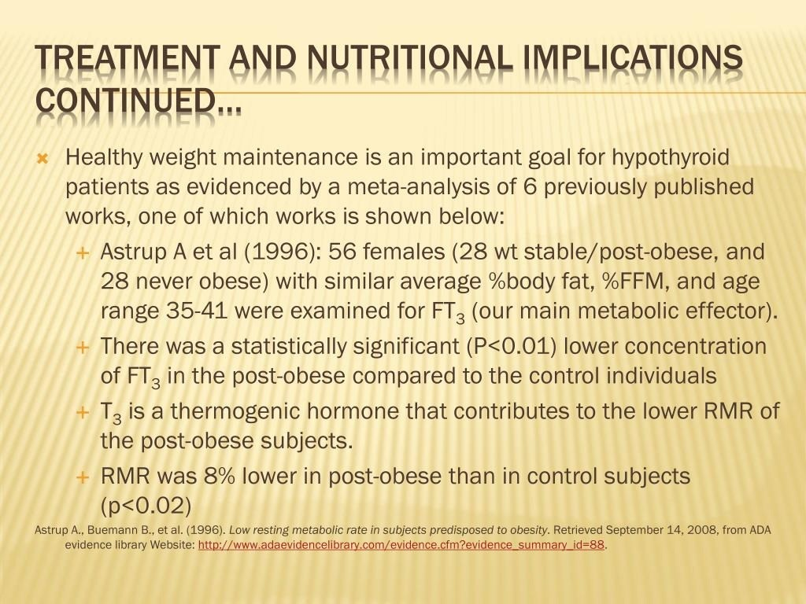

Slide 31
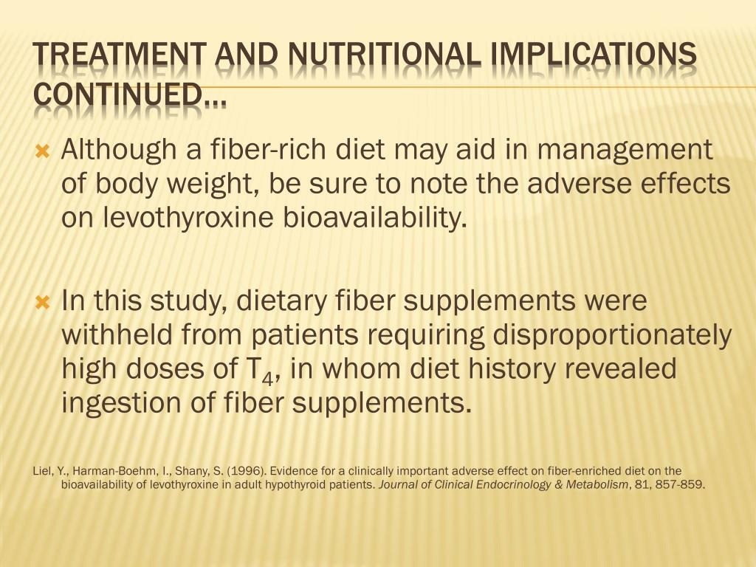

Slide 32
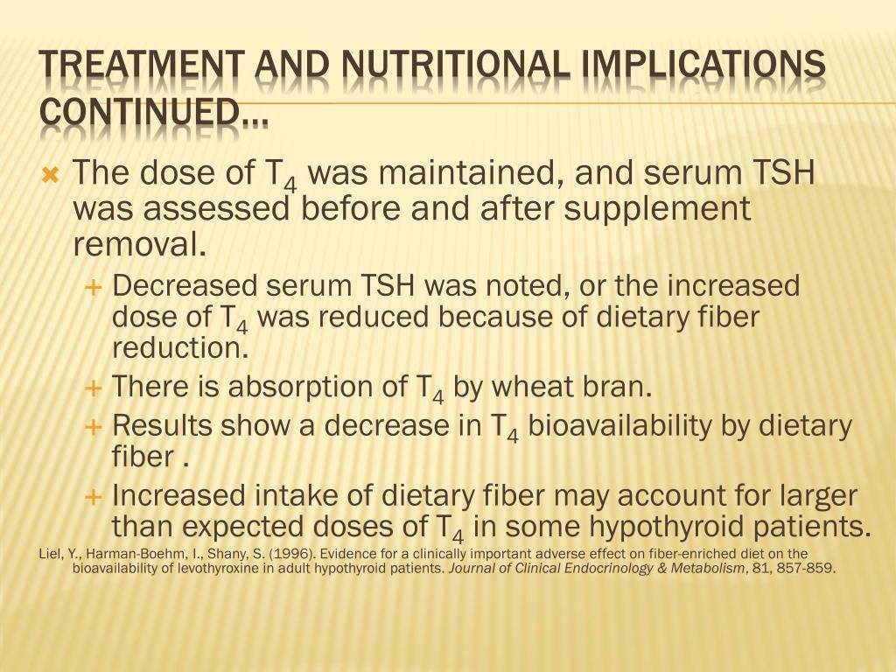

Slide 33
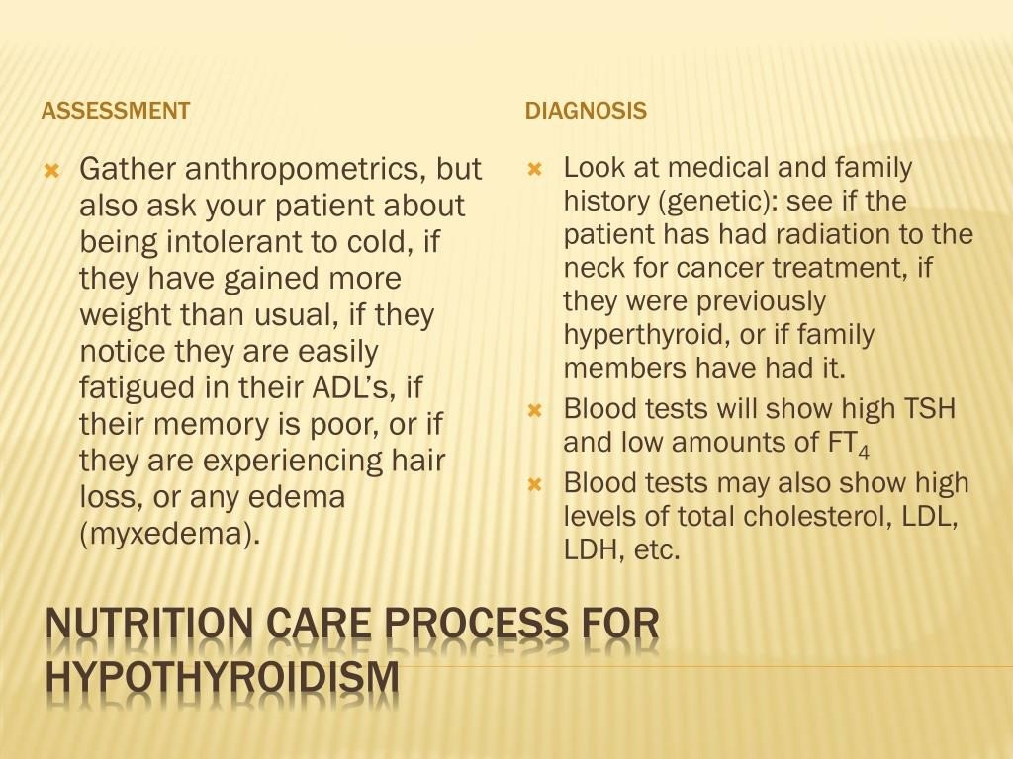

Slide 34
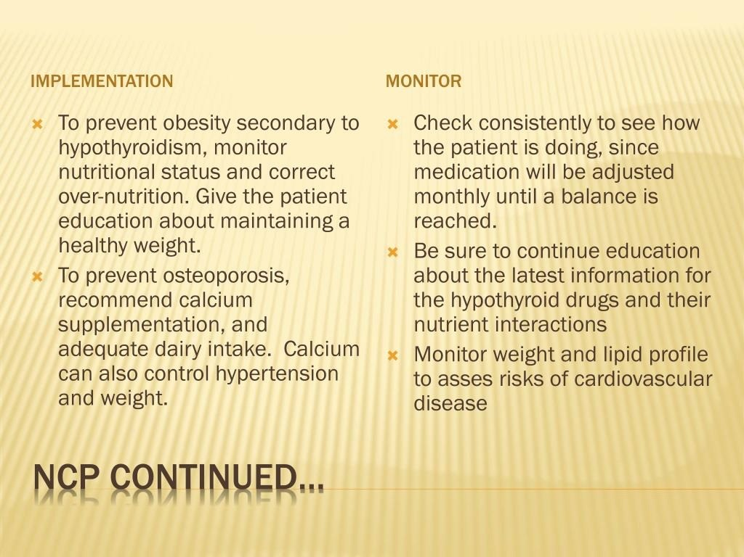

Slide 35
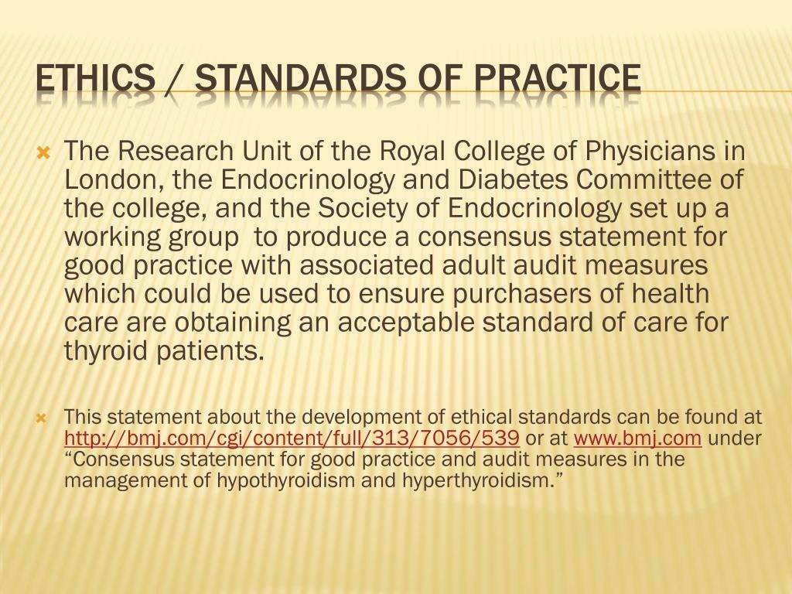

Slide 36
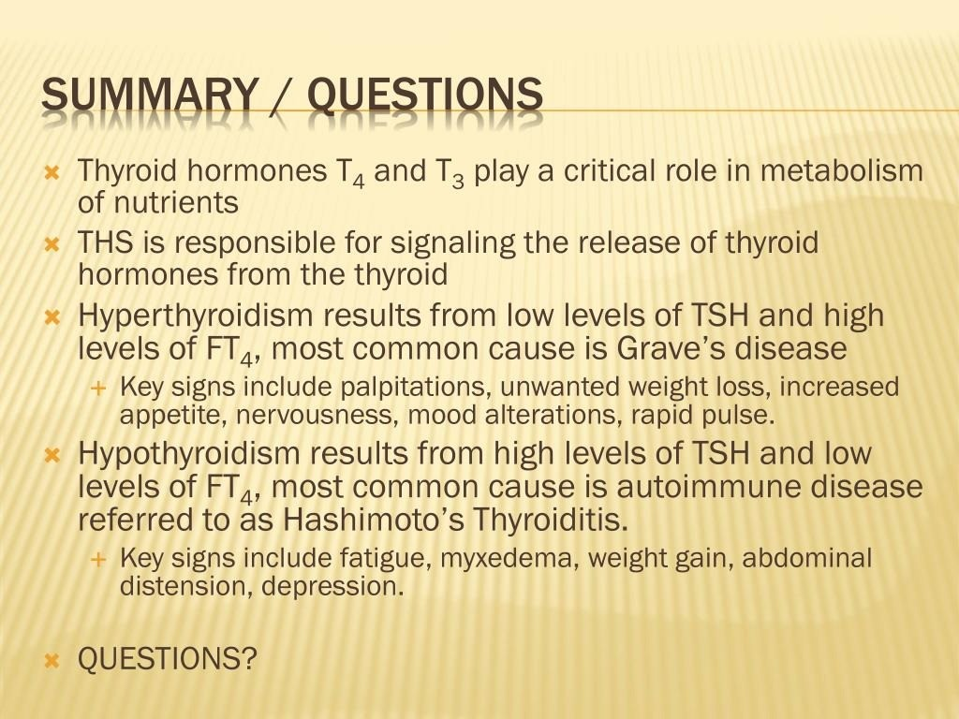

Slide 37
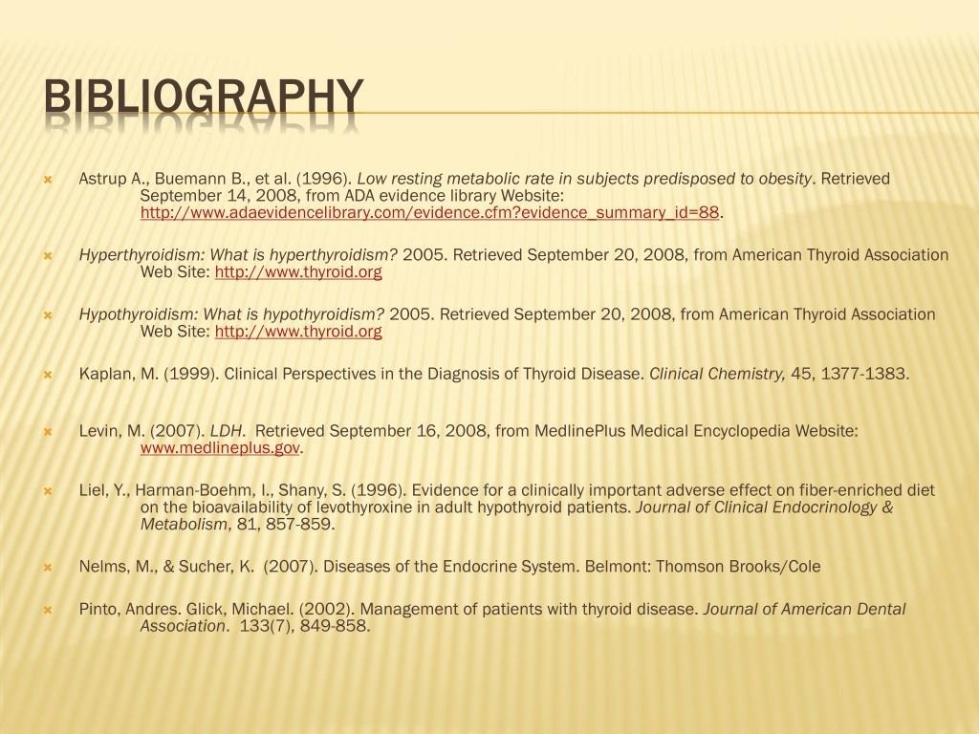

Slide 38
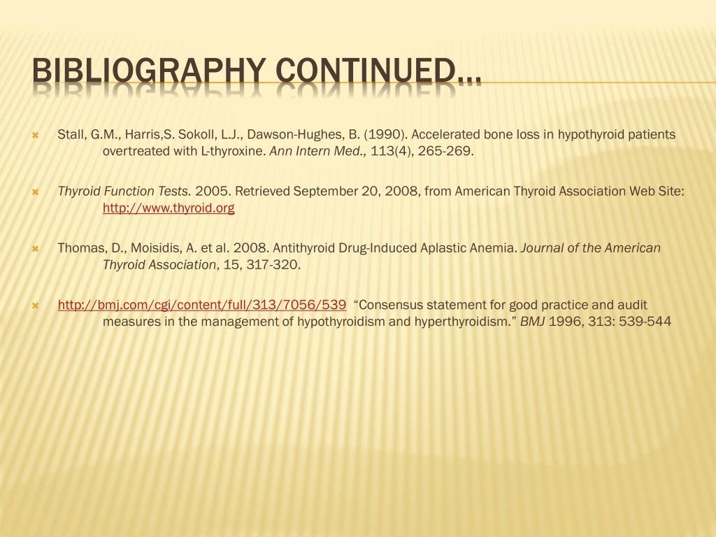

Slide 39
THANK YOU

